Slide 1
December 4 Progress Update
Benjamin Campbell

Slide 2
Updates since last meeting
Added pulse simulations to the model
Before it was a constant voltage
Implemented a new current calculation method
We were not actually computing current before
Now biases for applied voltage (this needs more tweaking)
Based on models used for photovoltaic cell semiconductors
Should still be faithful to the original model.
Attempted the simulation at various voltages and spatial dimensions to see how this affected the results
Got server access

Slide 3
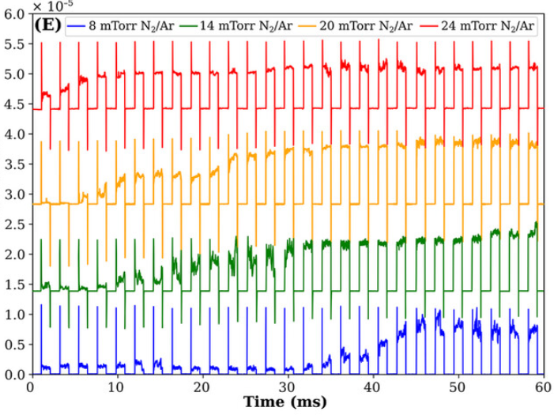
Inaccurate current modeling
Goal:
Model:
Ran in 99.21463990211487 seconds

Slide 4
Old Current Model
Input:
(x,y) for each particle
L - Length of device
λ –
R_{t} –
Steps – number of steps of the simulation
Num_e - Number of electrons
If min(L-x) < L/2
Return current is 0
(Efficiency measure)
Else
Sample the path of Num_e electrons and determine the resistance of each path.

Slide 5
New Current Model
Input:
(x,y) for each particle
L - Length of device
λ – Effective tunneling length
R_{t} – tunnelling resistance amplitude (constant)
Num_e - Number of electrons
T – Temperature of the system
If min(L-x) < L/2
Return current is 0
(Efficiency measure)
Else
Select the num_e closest particles to the electrode and have an electron jump to them.
Add reciprocals of each path together and then take the reciprocal. Return this times the voltage.
Compute the hopping resistance; modified by voltage bias.
Idea I am skeptical about:
Tried to compute each path as a parallel classical resistor –issue is that even one moderately small resistance throughs off the computation of the reciprocals.

Slide 6
Impact on model performance
Much faster – can render an extra 300 frames of the animation in the same amount of time.
I can run this on my laptop – will need the server to prepare figures for the paper since we will want higher definition.

Slide 7
Effect on the current time-series
This one was generated when I forgot to add the final resistance. Still has the correct shape though.
With final resistance and truncated to sample electrons starting near the electrode. Shape is not desired.

Slide 8
Effect on the current time-series (Cont.)
With final resistance and truncated to sample electrons starting near the electrode. Shape is decent. – Only sampled a single path. Current is still way too large.

Slide 9
How can we change the pinning potentials to engender the desired result

Slide 10
Next Steps
Think about modeling relaxation
Cut off the voltage for a period of time, particles move to electrodes
Refine the Current calculation
The implementation is currently a proof of concept and not theoretically rigorous for the current application
The papers I based the model off of were about organic polymers.
I want to add a way to manually import a pinning potential map so that I can generate them separately and then test.
Should be easy – just clone the current generator into a script and save the spatial array as a CSV.
This is then easy to import later.
Match time scales of data and model
What we are computing as current is not tied to the time scale of the simulation – it is not actual current.
Make the current sim more robust with Monte-Carlo samples. (or show error is small in current method – seems hard)
What happened when we up the number of particles? (500 currently)

